Slide 1

CSE221: Algorithms
Strongly Connected Components
Prepared by: A B M Muntasir Rahman [MUNR]

Slide 2
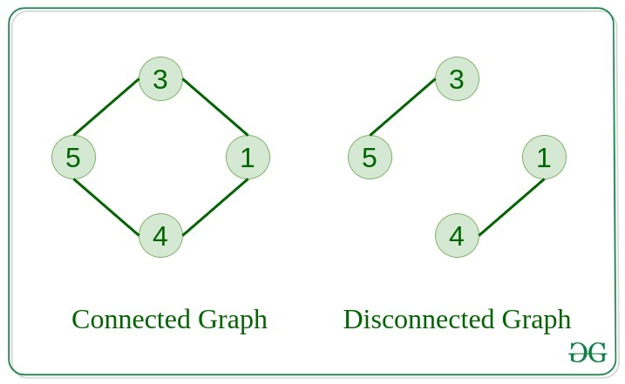
Connected Components

Slide 3
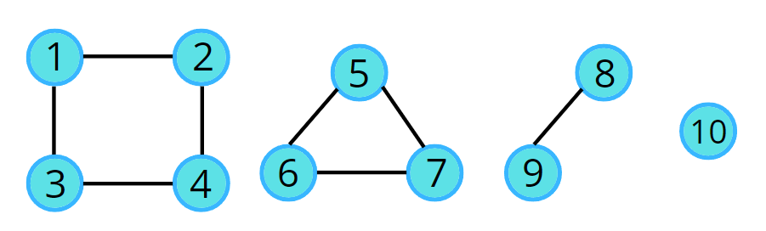
Connected Components
How many connected components here? How do we visit all of them?

Slide 4
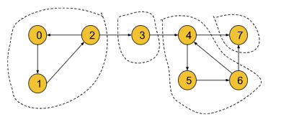
Strongly Connected Components
A component is called a Strongly Connected Component (SCC) only if for every possible pair of vertices (u, v) inside that component, u is reachable from v and v is reachable from u.
In this graph, [0, 1, 2] is a strongly connected component. Here, we can reach from 0 to 1 and vice versa, 1 to 2 and vice versa and 2 to 0 and vice versa.

Slide 5
Strongly Connected Components
Similarly, in this graph, there are 4 strongly connected components, [0, 1, 2], [3], [4, 5, 6] and 7.

Slide 6
Kosaraju’s Algorithm
Run DFS on the initial graph from the source vertex and record their start and end times.
1
5
6
0
2
3
4
7
Visited
Start Time
0 | 0 | 0 | 0 | 0 | 0 | 0 | 0
0 | 0 | 0 | 0 | 0 | 0 | 0 | 0
0 1 2 3 4 5 6 7
0 1 2 3 4 5 6 7
End Time
0 | 0 | 0 | 0 | 0 | 0 | 0 | 0
0 1 2 3 4 5 6 7

Slide 7
Kosaraju’s Algorithm
Run DFS on the initial graph from the source vertex and record their start and end times.
1
5
6
0
2
3
4
7
Visited
Start Time
1 | 0 | 0 | 0 | 0 | 0 | 0 | 0
1 | 0 | 0 | 0 | 0 | 0 | 0 | 0
0 1 2 3 4 5 6 7
0 1 2 3 4 5 6 7
End Time
0 | 0 | 0 | 0 | 0 | 0 | 0 | 0
0 1 2 3 4 5 6 7

Slide 8
Kosaraju’s Algorithm
Run DFS on the initial graph from the source vertex and record their start and end times.
1
5
6
0
2
3
4
7
Visited
Start Time
1 | 1 | 0 | 0 | 0 | 0 | 0 | 0
1 | 2 | 0 | 0 | 0 | 0 | 0 | 0
0 1 2 3 4 5 6 7
0 1 2 3 4 5 6 7
End Time
0 | 0 | 0 | 0 | 0 | 0 | 0 | 0
0 1 2 3 4 5 6 7

Slide 9
Kosaraju’s Algorithm
Run DFS on the initial graph from the source vertex and record their start and end times.
1
5
6
0
2
3
4
7
Visited
Start Time
1 | 1 | 1 | 0 | 0 | 0 | 0 | 0
1 | 2 | 3 | 0 | 0 | 0 | 0 | 0
0 1 2 3 4 5 6 7
0 1 2 3 4 5 6 7
End Time
0 | 0 | 0 | 0 | 0 | 0 | 0 | 0
0 1 2 3 4 5 6 7

Slide 10
Kosaraju’s Algorithm
Run DFS on the initial graph from the source vertex and record their start and end times.
1
5
6
0
2
3
4
7
Visited
Start Time
1 | 1 | 1 | 1 | 0 | 0 | 0 | 0
1 | 2 | 3 | 4 | 0 | 0 | 0 | 0
0 1 2 3 4 5 6 7
0 1 2 3 4 5 6 7
End Time
0 | 0 | 0 | 0 | 0 | 0 | 0 | 0
0 1 2 3 4 5 6 7

Slide 11
Kosaraju’s Algorithm
Run DFS on the initial graph from the source vertex and record their start and end times.
1
5
6
0
2
3
4
7
Visited
Start Time
1 | 1 | 1 | 1 | 1 | 0 | 0 | 0
1 | 2 | 3 | 4 | 5 | 0 | 0 | 0
0 1 2 3 4 5 6 7
0 1 2 3 4 5 6 7
End Time
0 | 0 | 0 | 0 | 0 | 0 | 0 | 0
0 1 2 3 4 5 6 7

Slide 12
Kosaraju’s Algorithm
Run DFS on the initial graph from the source vertex and record their start and end times.
1
5
6
0
2
3
4
7
Visited
Start Time
1 | 1 | 1 | 1 | 1 | 1 | 0 | 0
1 | 2 | 3 | 4 | 5 | 6 | 0 | 0
0 1 2 3 4 5 6 7
0 1 2 3 4 5 6 7
End Time
0 | 0 | 0 | 0 | 0 | 0 | 0 | 0
0 1 2 3 4 5 6 7

Slide 13
Kosaraju’s Algorithm
Run DFS on the initial graph from the source vertex and record their start and end times.
1
5
6
0
2
3
4
7
Visited
Start Time
1 | 1 | 1 | 1 | 1 | 1 | 1 | 0
1 | 2 | 3 | 4 | 5 | 6 | 7 | 0
0 1 2 3 4 5 6 7
0 1 2 3 4 5 6 7
End Time
0 | 0 | 0 | 0 | 0 | 0 | 0 | 0
0 1 2 3 4 5 6 7

Slide 14
Kosaraju’s Algorithm
Run DFS on the initial graph from the source vertex and record their start and end times.
1
5
6
0
2
3
4
7
Visited
Start Time
1 | 1 | 1 | 1 | 1 | 1 | 1 | 1
1 | 2 | 3 | 4 | 5 | 6 | 7 | 8
0 1 2 3 4 5 6 7
0 1 2 3 4 5 6 7
End Time
0 | 0 | 0 | 0 | 0 | 0 | 0 | 0
0 1 2 3 4 5 6 7

Slide 15
Kosaraju’s Algorithm
Run DFS on the initial graph from the source vertex and record their start and end times.
1
5
6
0
2
3
4
7
Visited
Start Time
1 | 1 | 1 | 1 | 1 | 1 | 1 | 1
1 | 2 | 3 | 4 | 5 | 6 | 7 | 8
0 1 2 3 4 5 6 7
0 1 2 3 4 5 6 7
End Time
0 | 0 | 0 | 0 | 0 | 0 | 0 | 9
0 1 2 3 4 5 6 7

Slide 16
Kosaraju’s Algorithm
Run DFS on the initial graph from the source vertex and record their start and end times.
1
5
6
0
2
3
4
7
Visited
Start Time
1 | 1 | 1 | 1 | 1 | 1 | 1 | 1
1 | 2 | 3 | 4 | 5 | 6 | 7 | 8
0 1 2 3 4 5 6 7
0 1 2 3 4 5 6 7
End Time
0 | 0 | 0 | 0 | 0 | 0 | 10 | 9
0 1 2 3 4 5 6 7

Slide 17
Kosaraju’s Algorithm
Run DFS on the initial graph from the source vertex and record their start and end times.
1
5
6
0
2
3
4
7
Visited
Start Time
1 | 1 | 1 | 1 | 1 | 1 | 1 | 1
1 | 2 | 3 | 4 | 5 | 6 | 7 | 8
0 1 2 3 4 5 6 7
0 1 2 3 4 5 6 7
End Time
0 | 0 | 0 | 0 | 0 | 11 | 10 | 9
0 1 2 3 4 5 6 7

Slide 18
Kosaraju’s Algorithm
Run DFS on the initial graph from the source vertex and record their start and end times.
1
5
6
0
2
3
4
7
Visited
Start Time
1 | 1 | 1 | 1 | 1 | 1 | 1 | 1
1 | 2 | 3 | 4 | 5 | 6 | 7 | 8
0 1 2 3 4 5 6 7
0 1 2 3 4 5 6 7
End Time
0 | 0 | 0 | 0 | 12 | 11 | 10 | 9
0 1 2 3 4 5 6 7

Slide 19
Kosaraju’s Algorithm
Run DFS on the initial graph from the source vertex and record their start and end times.
1
5
6
0
2
3
4
7
Visited
Start Time
1 | 1 | 1 | 1 | 1 | 1 | 1 | 1
1 | 2 | 3 | 4 | 5 | 6 | 7 | 8
0 1 2 3 4 5 6 7
0 1 2 3 4 5 6 7
End Time
0 | 0 | 0 | 13 | 12 | 11 | 10 | 9
0 1 2 3 4 5 6 7

Slide 20
Kosaraju’s Algorithm
Run DFS on the initial graph from the source vertex and record their start and end times.
1
5
6
0
2
3
4
7
Visited
Start Time
1 | 1 | 1 | 1 | 1 | 1 | 1 | 1
1 | 2 | 3 | 4 | 5 | 6 | 7 | 8
0 1 2 3 4 5 6 7
0 1 2 3 4 5 6 7
End Time
0 | 0 | 14 | 13 | 12 | 11 | 10 | 9
0 1 2 3 4 5 6 7

Slide 21
Kosaraju’s Algorithm
Run DFS on the initial graph from the source vertex and record their start and end times.
1
5
6
0
2
3
4
7
Visited
Start Time
1 | 1 | 1 | 1 | 1 | 1 | 1 | 1
1 | 2 | 3 | 4 | 5 | 6 | 7 | 8
0 1 2 3 4 5 6 7
0 1 2 3 4 5 6 7
End Time
0 | 15 | 14 | 13 | 12 | 11 | 10 | 9
0 1 2 3 4 5 6 7

Slide 22
Kosaraju’s Algorithm
Run DFS on the initial graph from the source vertex and record their start and end times.
1
5
6
0
2
3
4
7
Visited
Start Time
1 | 1 | 1 | 1 | 1 | 1 | 1 | 1
1 | 2 | 3 | 4 | 5 | 6 | 7 | 8
0 1 2 3 4 5 6 7
0 1 2 3 4 5 6 7
End Time
16 | 15 | 14 | 13 | 12 | 11 | 10 | 9
0 1 2 3 4 5 6 7

Slide 23
Kosaraju’s Algorithm
Based on descending order of end time of vertices, put them in a reference stack.
1
5
6
End Time
16 | 15 | 14 | 13 | 12 | 11 | 10 | 9
0
2
3
4
7
0 1 2 3 4 5 6 7
So, descending order of vertices according to end time is 0, 1, 2, 3, 4, 5, 6, 7
7 6 5 4 3 2 1 0
Reference Stack

Slide 24
Kosaraju’s Algorithm
Now, transpose the given graph i.e. edge (u, v) becomes (v, u).
1
5
6
1
5
6
0
2
3
4
7
0
2
3
4
7

Slide 25
Kosaraju’s Algorithm
Run DFS according to the order of vertices from the reference stack on transposed graph.
1
5
6
0
2
3
4
7
Visited
0 | 0 | 0 | 0 | 0 | 0 | 0 | 1
0 1 2 3 4 5 6 7
7 6 5 4 3 2 1 0
Reference Stack

Slide 26
Kosaraju’s Algorithm
Pop the vertex from the stack i.e. 0 in this case and run DFS starting from 0 on the transposed graph.
1
5
6
DFS(0)
0
2
3
4
7
Visited
1 | 0 | 0 | 0 | 0 | 0 | 0 | 0
0 1 2 3 4 5 6 7
7 6 5 4 3 2 1
Reference Stack

Slide 27
Kosaraju’s Algorithm
1
5
6
DFS(0) -> DFS(2)
0
2
3
4
7
Visited
1 | 0 | 1 | 0 | 0 | 0 | 0 | 0
0 1 2 3 4 5 6 7
7 6 5 4 3 2 1
Reference Stack

Slide 28
Kosaraju’s Algorithm
1
5
6
DFS(0) -> DFS(2) -> DFS(1)
0
2
3
4
7
Visited
1 | 1 | 1 | 0 | 0 | 0 | 0 | 0
0 1 2 3 4 5 6 7
7 6 5 4 3 2 1
Reference Stack

Slide 29
Kosaraju’s Algorithm
1
5
6
DFS(0) -> DFS(2) -> DFS(1)
Now, from 1 we can go to 0 however it is already visited. Since there are no unvisited vertex, we’ll backtrack to 2 and from 2, we’ll backtrack to 0. Therefore, [0, 2, 1] is our first SCC.
0
2
3
4
7
Visited
1 | 1 | 1 | 0 | 0 | 0 | 0 | 0
0 1 2 3 4 5 6 7
7 6 5 4 3 2 1
Reference Stack

Slide 30
Kosaraju’s Algorithm
Pop the vertex from the stack i.e. 1 in this case. However, 1 is already visited.
1
5
6
0
2
3
4
7
Visited
1 | 1 | 1 | 0 | 0 | 0 | 0 | 0
0 1 2 3 4 5 6 7
7 6 5 4 3 2
Reference Stack

Slide 31
Kosaraju’s Algorithm
Pop the vertex from the stack i.e. 2 in this case. However, 2 is already visited.
1
5
6
0
2
3
4
7
Visited
1 | 1 | 1 | 0 | 0 | 0 | 0 | 0
0 1 2 3 4 5 6 7
7 6 5 4 3
Reference Stack

Slide 32
Kosaraju’s Algorithm
Pop the vertex from the stack i.e. 3 in this case. Run DFS from 3.
1
5
6
DFS(3) From 3, we can go to 2. However, 2 is already visited. As we don’t have any other adjacent vertices, 3 is our second SCC.
0
2
3
4
7
Visited
1 | 1 | 1 | 1 | 0 | 0 | 0 | 0
0 1 2 3 4 5 6 7
7 6 5 4
Reference Stack

Slide 33
Kosaraju’s Algorithm
Pop the vertex from the stack i.e. 4 in this case. Run DFS from 4.
1
5
6
DFS(4)
0
2
3
4
7
Visited
1 | 1 | 1 | 1 | 1 | 0 | 0 | 0
0 1 2 3 4 5 6 7
7 6 5
Reference Stack

Slide 34
Kosaraju’s Algorithm
1
5
6
DFS(4) -> DFS(6)
0
2
3
4
7
Visited
1 | 1 | 1 | 1 | 1 | 0 | 1 | 0
0 1 2 3 4 5 6 7
7 6 5
Reference Stack

Slide 35
Kosaraju’s Algorithm
1
5
6
DFS(4) -> DFS(6) -> DFS(5)
0
2
3
4
7
Visited
1 | 1 | 1 | 1 | 1 | 1 | 1 | 0
0 1 2 3 4 5 6 7
7 6 5
Reference Stack

Slide 36
Kosaraju’s Algorithm
1
5
6
DFS(4) -> DFS(6) -> DFS(5)
From 5 we can go to 4. However, it is already visited. So, we’ll backtrack from 5 to 6, and then 6 to 4. Since 4 doesn’t have any adjacent vertices, therefore, [4, 6, 5] is our third SCC.
0
2
3
4
7
Visited
1 | 1 | 1 | 1 | 1 | 1 | 1 | 0
0 1 2 3 4 5 6 7
7 6 5
Reference Stack

Slide 37
Kosaraju’s Algorithm
Pop the vertex from the stack i.e. 5 in this case. However, 5 is already visited.
1
5
6
0
2
3
4
7
Visited
1 | 1 | 1 | 1 | 1 | 1 | 1 | 0
0 1 2 3 4 5 6 7
7 6
Reference Stack

Slide 38
Kosaraju’s Algorithm
Pop the vertex from the stack i.e. 6 in this case. However, 6 is already visited.
1
5
6
0
2
3
4
7
Visited
1 | 1 | 1 | 1 | 1 | 1 | 1 | 0
0 1 2 3 4 5 6 7
7
Reference Stack

Slide 39
Kosaraju’s Algorithm
Pop the vertex from the stack i.e. 7 in this case. Run DFS from 7.
1
5
6
DFS(7)
0
2
3
4
7
Visited
1 | 1 | 1 | 1 | 1 | 1 | 1 | 1
0 1 2 3 4 5 6 7
Reference Stack

Slide 40
Kosaraju’s Algorithm
Pop the vertex from the stack i.e. 7 in this case. Run DFS from 7.
5
6
DFS(7)
7 has two adjacent vertices 4 and 6, however, both are already visited. Therefore, 7 is our fourth SCC.
[0, 2, 1]: SCC1
[3]: SCC2
[4, 6, 5]: SCC3
[7]: SCC4
This is Kosaraju’s Algorithm!
1
0
2
3
4
7
Visited
1 | 1 | 1 | 1 | 1 | 1 | 1 | 1
0 1 2 3 4 5 6 7
Reference Stack

